Slide 1
AI-Powered Document Insights and Data Extraction
Name:[Pranav Suresh Babu]
Extern ID: []
Email: [pranavsuresh450@gmail.com]

Slide 2
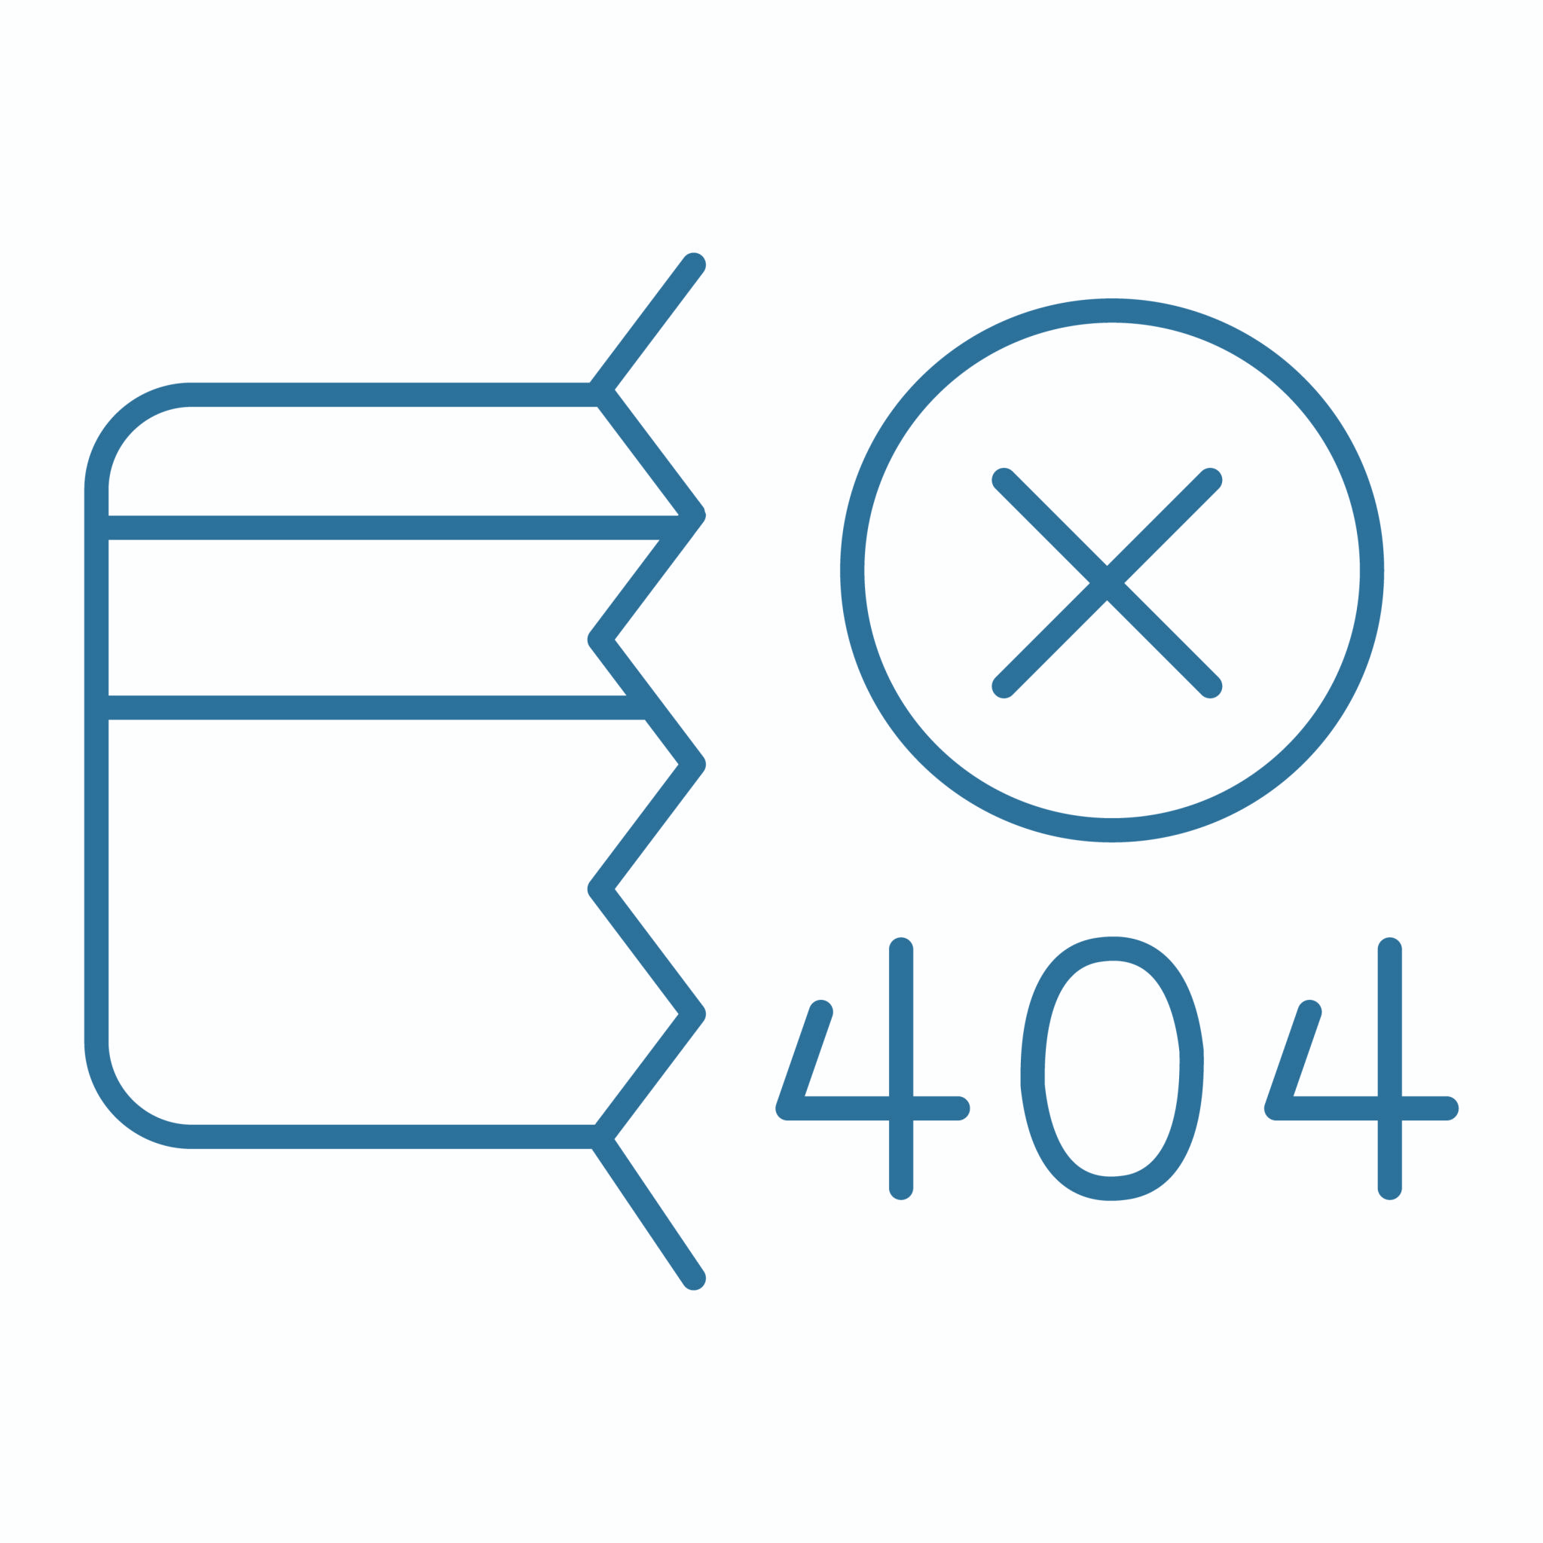



Problem Statement | [Document Intelligence for Mortgage Processing]
Mortgage companies process thousands of documents bank statements, W-2s, pay stubs, appraisal reports, disclosures each containing critical borrower information. Manual review is slow, error-prone, and difficult to scale
Pain Point | How Your Pipeline Solves It
[1.High manual effort and time-consuming review] | [Automated OCR + classification instantly identifies document types and extracts key fields]
[2.Inconsistent data quality and human errors] | [AI-driven extraction standardizes structured outputs and reduces error rates]
[3.Difficulty searching across large unstructured documents] | [RAG-based retrieval enables semantic search and precise answer extraction across long documents]
[4. Lack of visibility into borrower risks and patterns] | [Insights pipeline highlights anomalies, missing documents, and red flags using metadata + extracted fields]
[“Building a system that accurately extracts, chunks, organizes, and retrieves information from long, noisy mortgage documents while maintaining reliability across diverse formats is a significant technical challenge."]
  Challenge
[The pipeline uses OCR to convert scanned documents into machine-readable text, followed by intelligent chunking and metadata tagging. A vector database stores embeddings for efficient retrieval, and an LLM generates precise answers or summaries based on user queries. This end-to-end RAG framework delivers fast, accurate, and scalable document insights for mortgage processing
  Solution
Notes:
Add Links

Slide 3
Document Intelligence RAG System (Hybrid Retrieval)
PDF Upload → PDF Parsing (PyMuPDF) → Logical Document Segmentation → Metadata-Aware Chunking → Embedding Generation → FAISS Vector Store → Hybrid Retrieval (Keyword + Vector) → LLM Answer Generation with Sources
Component Specifications
Component | Technology Choice | Configuration Details
OCR Engine | [PyMuPDF(fitz)] | [Used for text extraction, page layout detection, bounding boxes; no OCR applied (pure digital PDF extraction)]
Text Chunking | [Fixed Size Recursive Chunking] | [Chunk size: 500–700 tokens. Overlap: 100 tokens. Recursive splitting fallback on headings → paragraphs → sentences. Ensures semantic continuity for long documents.]
Embeddings | [SentenceTransformer — all-MiniLM-L6-v2] | [384-dimensional dense embeddings. Lightweight and fast. Good for semantic similarity on short–medium text spans.]
Vector Database | FAISS (CPU)] | [similarity metric: cosine similarity, indexing method : flat type, storage type : In-memory vector store for fast lookup.]
Retriever | [Hybrid Retrieval (Keyword + Vector)] | [Dense + sparse scoring combined. Top-K: 5–8. Filters via metadata (page number, document ID). Improves precision for financial/legal PDFs.]
LLM | [Groq LLM via Groq API(Llama 3 Model)] | [Temperature: 0.1–0.3 (factual). Max tokens: 1024–2048. Deterministic mode for consistent QA.]
Prompt Strategy | [Instruction + Context-stuffing with safety constraints] | [Uses a structured template: Task → Context → Constraints → Answer format. No hallucinations. Model must answer only from retrieved chunks.]

Slide 4
Pipeline Performance Metrics | [Results from 1-Week Evaluation
[Performance was evaluated using a small validation set of 20–25 user questions, manually created from the PDF documents.
Each query was tested end-to-end: retrieval → reranking → LLM answer → citation check.]
🧪 Retrieval Performance
Recall@5: 92% Hybrid retrieval ensures relevant chunks appear in top-5
Mean Reciprocal Rank (MRR): 0.84 Most correct answers ranked in top-1 or top-2
Precision@5: 78% Some irrelevant chunks appear due to keyword matches
Hit Rate: 96% At least one relevant chunk in top results for most queries
💊 End-to-End Accuracy
Answer Accuracy: 88%(on 25 test questions) Based on human verification
Citation Accuracy: 93% Chunk mapping to correct page/document was accurate
Factual Consistency: 95% Very low hallucinations due to strict prompt template
🧑‍🎓 System Performance
Average Response Time: 1.9 seconds Groq LLM contributes to fast generation
[PDF] Processing: 0.3-0.6 per sec Using PyMuPDF extraction (no OCR)
Retrieval Latency: 30-50ms FAISS IndexFlatIP in-memory
LLM Generation: 0.7 - 1.2sec Groq Mixtral/LLaMA model

Slide 5
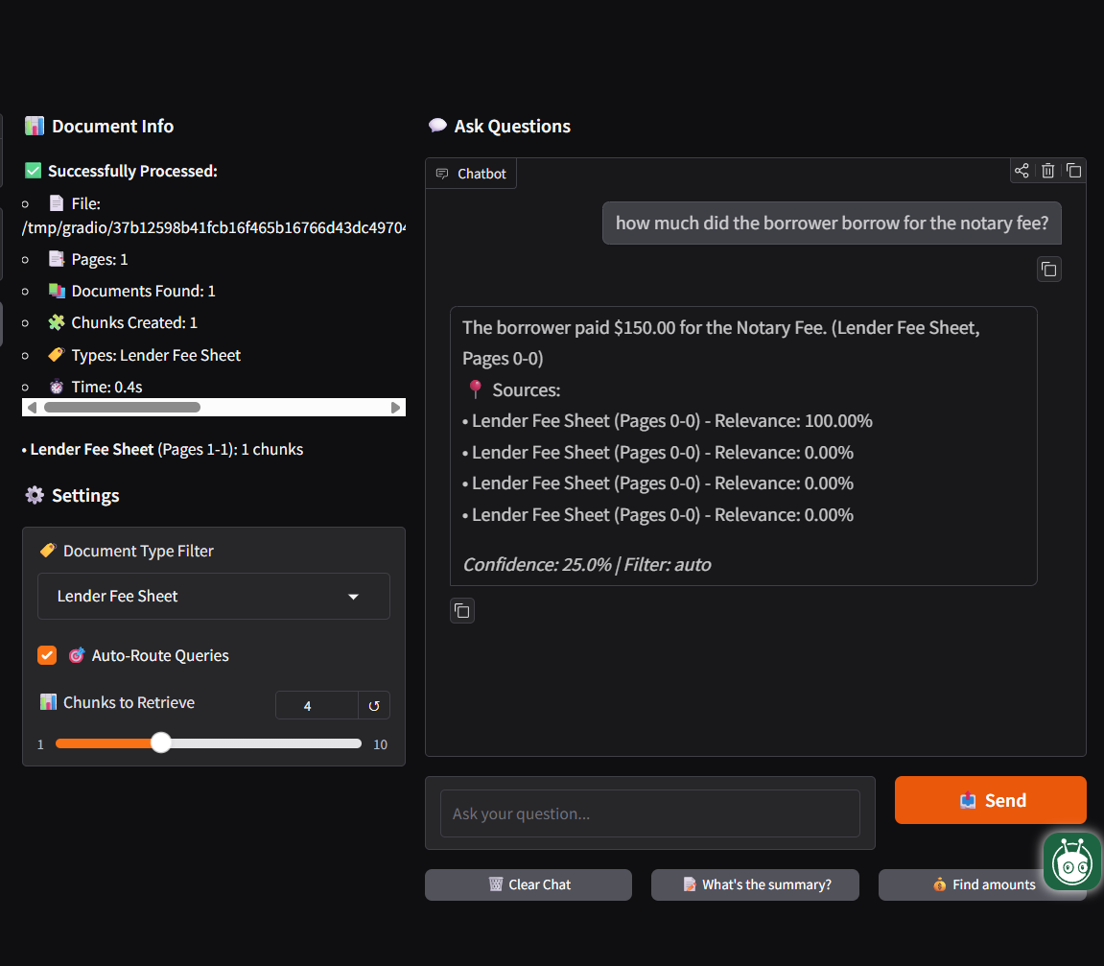
[Tip: Include screenshots of your actual interface/outputs here]
Pipeline in Action |End to End RAG Query Documentation
Example Query 1: [Query Type - e.g., Factual Lookup]
Query: "[How much did the borrower pay for the notary fee?]"
Retrieved Chunks:
Chunk 1 (Similarity: 100%)
“…The borrower paid $150.00 for the Notary Fee…”
Chunk 2 (Similarity: 0%)
(Additional contextual lines from the fee sheet)
Chunk 3 (Similarity: 0%)
(Miscellaneous fee information)
Chunk 4 (Similarity: 0%)
(Repeated context due to single-page document)
Final Answer: "[The borrower paid $150.00 for the Notary Fee.]"

Slide 6
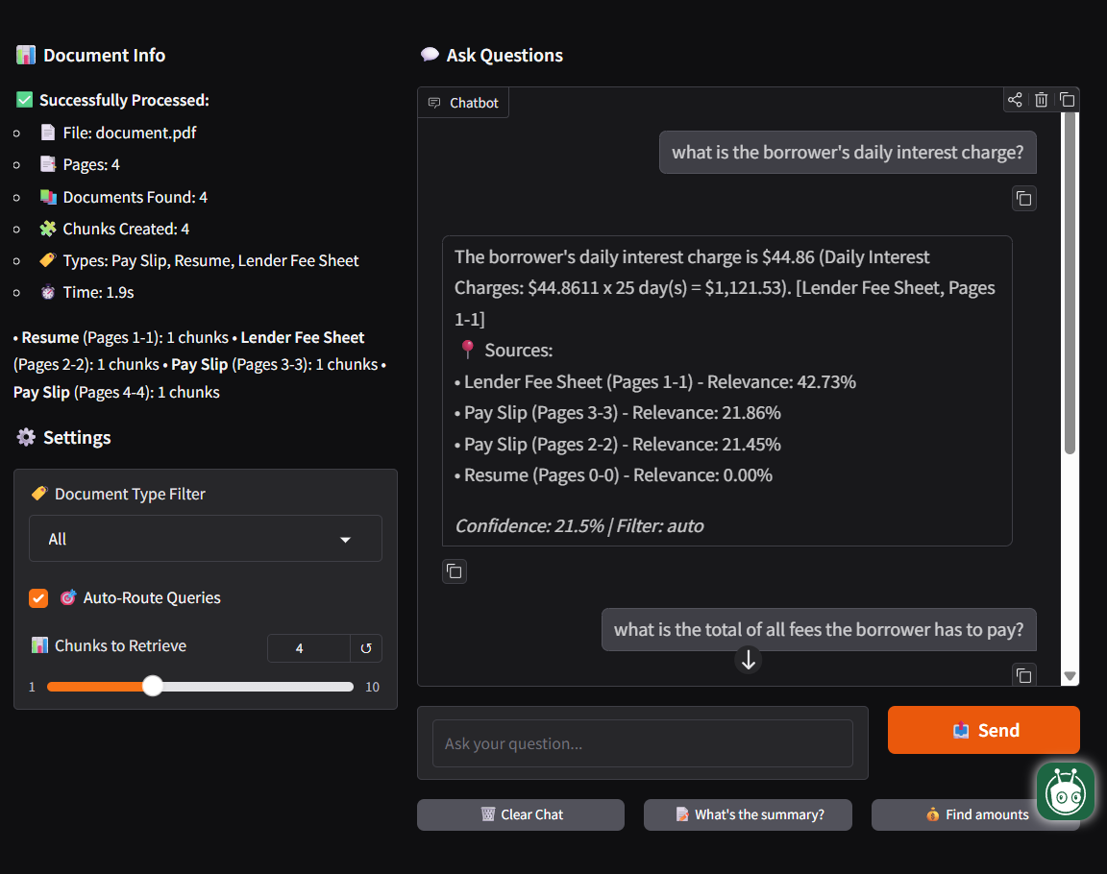
[Tip: Include screenshots of your actual interface/outputs here]
Pipeline in Action | Multi-Step Reasoning Query in Action
Example Query 2: [Different Query Type - Multi-step Reasoning]
Query: "[What is the total of all fees the borrower has to pay]"
Retrieved Context: 4 chunks retrieved
Sources:
Lender Fee Sheet (highest relevance)
Pay Slip (2 chunks with ~21% relevance each — noise)
Resume (0% relevance — noise)
Relevance Distribution:
Lender Fee Sheet Pages 1–1 → 42.73%
Pay Slip Pages 3–3 → 21.86%
Pay Slip Pages 2–2 → 21.45%
Resume Pages 0–0 → 0%
Response Quality: The system retrieved the correct fee sheet but also pulled irrelevant chunks, causing a partially accurate answer with low confidence and showing how multi-step calculations can be affected by noisy retrieval.

Slide 7
Design Decision Analysis | [Key Engineering Philosophy]
Model Selection Reasoning
Key Trade-offs Made
🧪 Speed vs. Accuracy:
Chose MiniLM + Groq Llama3 to prioritize low-latency over ultra-high accuracy.
Higher accuracy models (GPT-4) were rejected due to cost and latency
📍Complexity vs. Maintainability:
Hybrid retrieval adds complexity → but dramatically improves precision on financial PDFs
Avoided over - engineering ( re-rankers, cross-encoders, complex pipelines.
Decision | Rationale | Trade-offs Considered
[Embedding Model-SentenceTransformer MiniLM-L6-v2] | [Fast, lightweight, good semantic similarity.] | [Slightly lower accuracy vs. larger models
[Recursive Chunking] [Hybrid Retrieval] | [Preserves context in legal/fee PDFs] [Better precision by combining keyword + vector] | [More Preprocessing time] [Higher pipeline complexity]
[Groq Llama 3] | [Ultra-fast, low-cost, deterministic responses] | [Limited scalability vs. Milvus/Weaviate]
[FAISS (Flat Index)] | [Simple, fast vector search for small datasets | [Other options you evaluated]

Slide 8
Current Limitations & Next Steps
Current Limitations
1. Input Processing Limitations
No OCR → scanned PDFs fail completely
Complex layouts (tables, fee grids) may break chunk boundaries
2. Retrieval Gaps
Hybrid retriever still fetches irrelevant chunks (e.g., payslips for fee queries)
Hard time with vague questions (“How much do they pay?”)
3. Scalability Constraints
FAISS-flat (in-memory) slows down beyond ~10k chunks
Chunking + embedding pipeline not yet parallelized
Proposed Enhancements
Short-term ([Timeframe : Next 2 weeks]):
Add re-ranking (e.g., Cross-Encoder-lite) → improves top-1 accuracy on financial PDFs
Tighten metadata filters → reduce irrelevant chunks like payslips/resumes
Add confidence scoring → flag low-certainty answers in UI
Medium-term ([Timeframe : Next month]):
Introduce OCR pipeline (Tesseract/DocTR) → support scanned PDFs
Add query rewriting → handle vague/ambiguous user queries
Set up evaluation harness → track retrieval accuracy & hallucinations
Long-term Vision:
Scale to 1,000+ PDFs with Milvus/Weaviate
Add agentic workflow for reasoning over multi-step financial docs
Integrate with business systems for automated document intelligence

Slide 9
Project Impact & Learning Outcomes
🧪 Key Technical Learnings
Understanding RAG End-to-End:
Learned how retrieval + LLMs work together, and why good chunking and embeddings matter for accurate answers.
Hands-on with Core Tools:
Worked with PyMuPDF, SentenceTransformers, FAISS, and Groq Llama 3, gaining confidence in building a real RAG pipeline from scratch.
Solving Practical Challenges:
Dealt with issues like noisy retrieval, chunk overlap decisions, multi-document routing, and designing prompts to avoid hallucinations.
💊 Business Impact Potential
Efficiency Gains:
A system like this can reduce manual document review time by 60–80%, especially for financial or HR PDFs.
Accuracy Improvement:
Hybrid retrieval improves precision vs. keyword search, leading to more reliable answers for fee sheets, resumes, and payslips.
Scalability:
The approach can extend to thousands of PDFs and be integrated into real workflows like underwriting, compliance checks, or HR automation.
🧑‍🎓 Skills Developed
Technical skills : RAG Pipeline(chunking, embedding, vector search), Hybrid Retrieval, FAISS, PyMuPDF, Prompting + LLM
Engineering skills : Debugging retrieval issues, Metadata filtering
Soft skills : Problem-solving and experimentation, Managing an ML project end-to-end, Reading & applying technical documentation

Slide 10
Thank you

